Slide 1

Sevda Heydarova

Slide 2
Stages of generating my analysis
To import data from Microsoft Excel to Microsoft Power BI
To clean and transform data in Power BI using the Power Query Editor
Creating the measures I will use for the charts
Creating and designing my dashboard

Slide 3


Slide 4
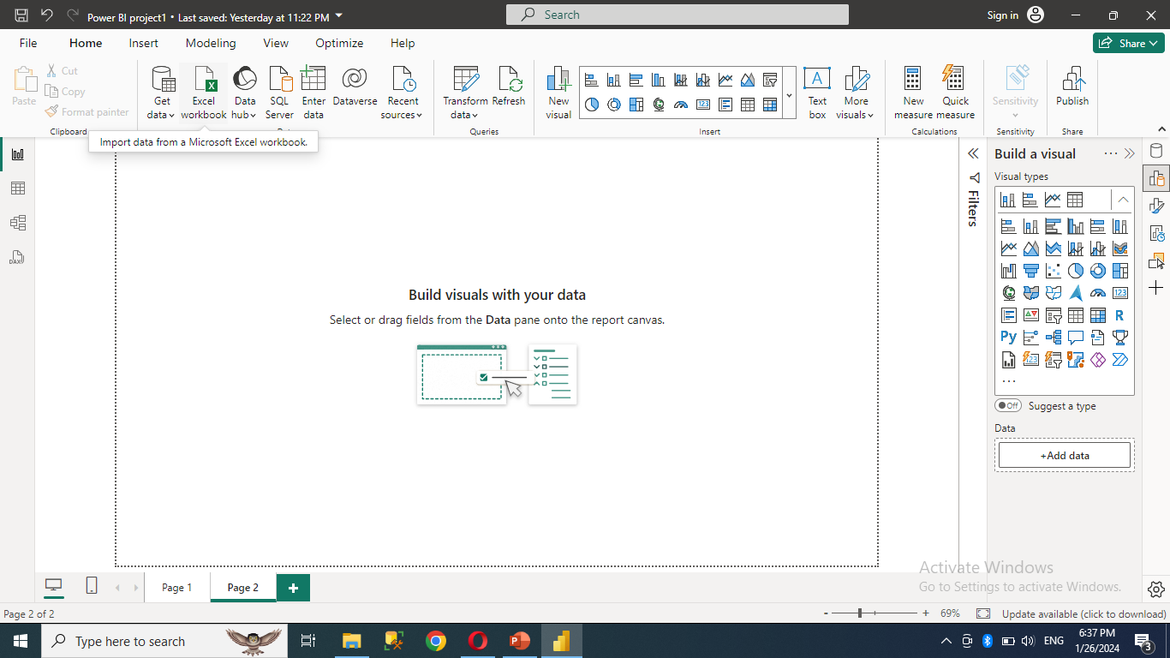
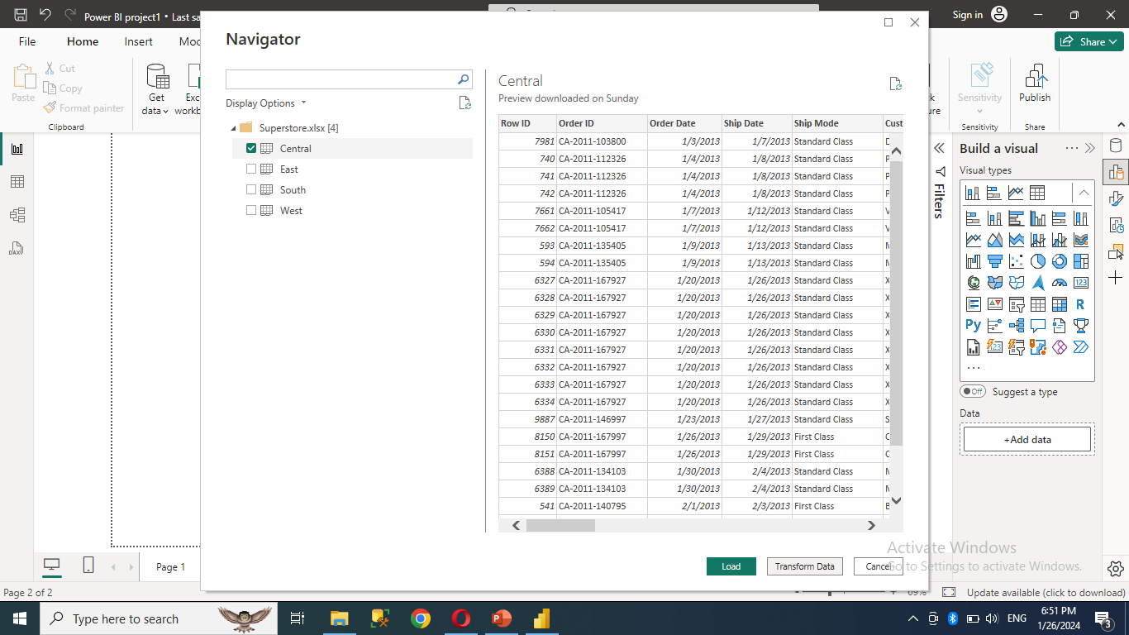
Let’s get started
1.Open Power BI Desktop> Home tab> click on “Excel workbook” as picture.
2. Transform Data to > Power Query Editor > Clean data

Slide 5
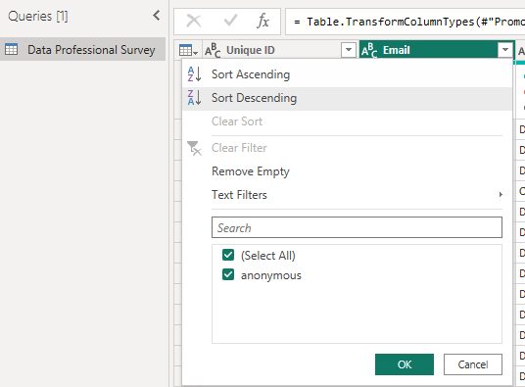
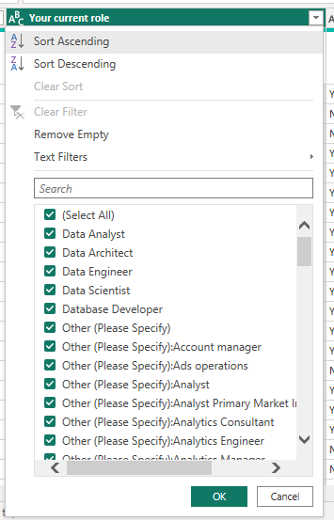
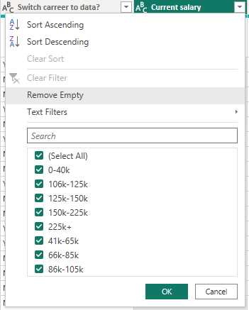
How did I clean data?
1. I deleted Email column. Because It had same value.
2. Your Current Role column has been streamlined by renaming diverse entries, such as 'Other (Please Specify):Analyst', 'Other (Please Specify)’, etc , to a standardized 'Other’. Industry, Programming Language and Country columns have been changed to the same.
3. I changed values of Current salary column from range to average salary. Because when I created chart, I didn’t need range.

Slide 6
How did I create measures
3.After transform clean data to Power BI Desktop > Modeling > New measure
Note: I created these measures for finding number of male, female and number of people satisfied or dissatisfied with their jobs.
And my step 4 is on the next page.

Slide 7
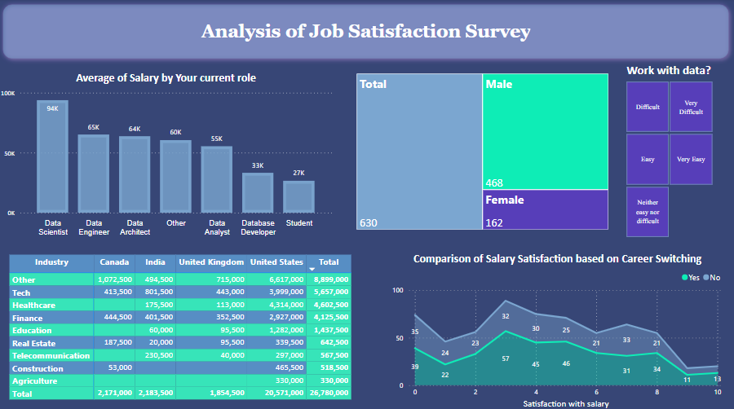

Slide 8

Analysis Time

Slide 9
Let's research that, How many data scientists working in the Finance and Technology sectors say that working with data is difficult and change their work or not based on their salary satisfaction scores?
Also, how many of them are men or women?

Slide 10
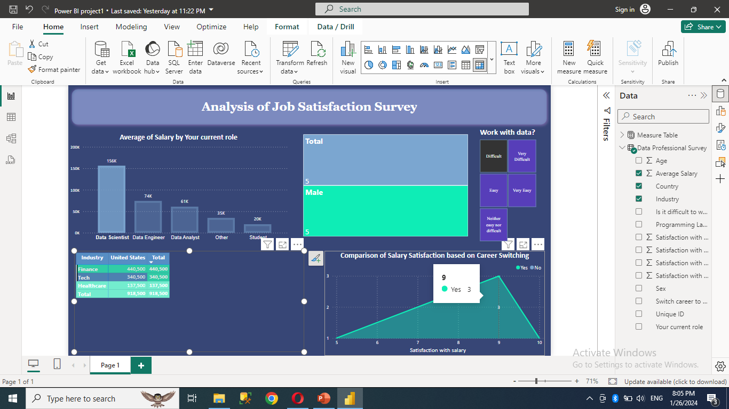
Note: You can analyze many situations using more than one method. I only showed.

Slide 11


